Slide 1

Inheritance, Encapsulation, Collections & I/O
Inheritance
Inheritance in Java is a mechanism in which one object acquires all the properties and behaviors of a parent object. It is an important part of OOPs (Object Oriented programming system).
The idea behind inheritance in Java is that you can create new classes that are built upon existing classes. When you inherit from an existing class, you can reuse methods and fields of the parent class. Moreover, you can add new methods and fields in your current class also.
Inheritance represents the IS-A relationship which is also known as a parent-child relationship
Java Full Stack Program

Slide 2
Inheritance, Encapsulation, Collections & I/O
Why use inheritance in java
For Method Overriding (so runtime polymorphism can be achieved).
For Code Reusability.
Terms used in Inheritance
Class: A class is a group of objects which have common properties. It is a template or blueprint from which objects are created.
Sub Class/Child Class: Subclass is a class which inherits the other class. It is also called a derived class, extended class, or child class.
Super Class/Parent Class: Superclass is the class from where a subclass inherits the features. It is also called a base class or a parent class.
Reusability: As the name specifies, reusability is a mechanism which facilitates you to reuse the fields and methods of the existing class when you create a new class. You can use the same fields and methods already defined in the previous class.
Java Full Stack Program

Slide 3
Inheritance, Encapsulation, Collections & I/O
The syntax of Java Inheritance
class Subclass-name extends Superclass-name
{
//methods and fields
}
The extends keyword indicates that you are making a new class that derives from an existing class. The meaning of "extends" is to increase the functionality.
In the terminology of Java, a class which is inherited is called a parent or superclass, and the new class is called child or subclass.
Java Full Stack Program

Slide 4
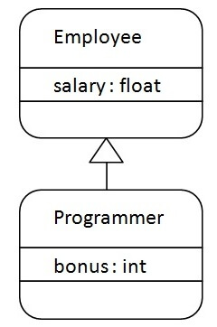
Inheritance, Encapsulation, Collections & I/O
Java Inheritance Example
Java Full Stack Program

Slide 5
Inheritance, Encapsulation, Collections & I/O
As displayed in the above figure, Programmer is the subclass and Employee is the superclass. The relationship between the two classes is Programmer IS-A Employee. It means that Programmer is a type of Employee.
Types of inheritance in java
On the basis of class, there can be three types of inheritance in java: single, multilevel and hierarchical.
In java programming, multiple and hybrid inheritance is supported through interface only. We will learn about interfaces later.
Java Full Stack Program

Slide 6
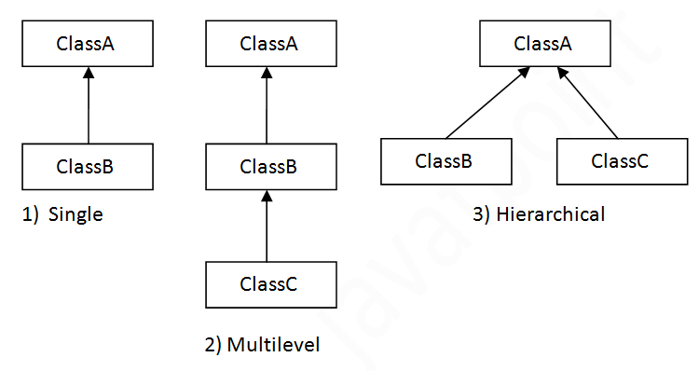
Inheritance, Encapsulation, Collections & I/O
Java Full Stack Program

Slide 7
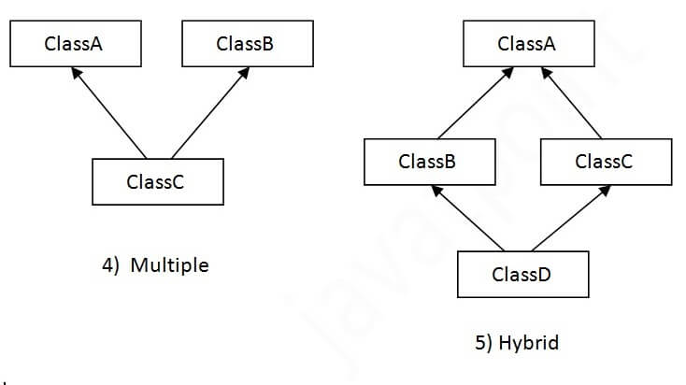
Inheritance, Encapsulation, Collections & I/O
Note : Multiple inheritance is not supported in Java through class.
When one class inherits multiple classes, it is known as multiple inheritance.
Java Full Stack Program

Slide 8
Inheritance, Encapsulation, Collections & I/O
Single Inheritance Example
When a class inherits another class, it is known as a single inheritance. In the example given below, Dog class inherits the Animal class, so there is the single inheritance.
Multilevel Inheritance Example
When there is a chain of inheritance, it is known as multilevel inheritance. As you can see in the example given below, BabyDog class inherits the Dog class which again inherits the Animal class, so there is a multilevel inheritance.
Hierarchical Inheritance Example
When two or more classes inherits a single class, it is known as hierarchical inheritance. In the example given below, Dog and Cat classes inherits the Animal class, so there is hierarchical inheritance.
.
Java Full Stack Program

Slide 9
Inheritance, Encapsulation, Collections & I/O
Why multiple inheritance is not supported in java?
To reduce the complexity and simplify the language, multiple inheritance is not supported in java.
Consider a scenario where A, B, and C are three classes. The C class inherits A and B classes. If A and B classes have the same method and you call it from child class object, there will be ambiguity to call the method of A or B class.
Since compile-time errors are better than runtime errors, Java renders compile-time error if you inherit 2 classes. So whether you have same method or different, there will be compile time error.
.
Java Full Stack Program

Slide 10
Inheritance, Encapsulation, Collections & I/O
Encapsulation in Java
Encapsulation in Java is a process of wrapping code and data together into a single unit, for example, a capsule which is mixed of several medicines.
We can create a fully encapsulated class in Java by making all the data members of the class private. Now we can use setter and getter methods to set and get the data in it.
The Java Bean class is the example of a fully encapsulated class.
Advantage of Encapsulation in Java
By providing only a setter or getter method, you can make the class read-only or write-only. In other words, you can skip the getter or setter methods.
Java Full Stack Program

Slide 11
Inheritance, Encapsulation, Collections & I/O
It provides you the control over the data. Suppose you want to set the value of id which should be greater than 100 only, you can write the logic inside the setter method. You can write the logic not to store the negative numbers in the setter methods.
It is a way to achieve data hiding in Java because other class will not be able to access the data through the private data members.
The encapsulate class is easy to test. So, it is better for unit testing.
The standard IDEs are providing the facility to generate the getters and setters. So, it is easy and fast to create an encapsulated class in Java.
Java Full Stack Program

Slide 12
Inheritance, Encapsulation, Collections & I/O
Collections in Java
Any group of individual objects which are represented as a single unit is known as the collection of the objects. In Java, a separate framework named the “Collection Framework” has been defined in JDK 1.2 which holds all the collection classes and interface in it. The Collection interface (java.util.Collection) and Map interface (java.util.Map) are the two main “root” interfaces of Java collection classes
What is a Framework? A framework is a set of classes and interfaces which provide a ready-made architecture. In order to implement a new feature or a class, there is no need to define a framework. However, an optimal object-oriented design always includes a framework with a collection of classes such that all the classes perform the same kind of task.
Need for a Separate Collection Framework Before the Collection Framework(or before JDK 1.2) was introduced, the standard methods for grouping Java objects (or collections) were Arrays or Vectors, or Hashtables. All of these collections had no common interface. Therefore, though the main aim of all the collections is the same, the implementation of all these collections was defined independently and had no correlation among them. And also, it is very difficult for the users to remember all the different methods, syntax, and constructors present in every collection class.
Java Full Stack Program

Slide 13
Inheritance, Encapsulation, Collections & I/O
Advantages of the Collection Framework: Since the lack of a collection framework gave rise to the above set of disadvantages, the following are the advantages of the collection framework.
Consistent API: The API has a basic set of interfaces like Collection, Set, List, or Map, all the classes (ArrayList, LinkedList, Vector, etc) that implement these interfaces have some common set of methods.
Reduces programming effort: A programmer doesn’t have to worry about the design of the Collection but rather he can focus on its best use in his program. Therefore, the basic concept of Object-oriented programming (i.e.) abstraction has been successfully implemented.
Increases program speed and quality: Increases performance by providing high-performance implementations of useful data structures and algorithms because in this case, the programmer need not think of the best implementation of a specific data structure. He can simply use the best implementation to drastically boost the performance of his algorithm/program.
Java Full Stack Program

Slide 14
Inheritance, Encapsulation, Collections & I/O
Hierarchy of the Collection Framework
The utility package, (java.util) contains all the classes and interfaces that are required by the collection framework. The collection framework contains an interface named an iterable interface which provides the iterator to iterate through all the collections. This interface is extended by the main collection interface which acts as a root for the collection framework. All the collections extend this collection interface thereby extending the properties of the iterator and the methods of this interface. The following figure illustrates the hierarchy of the collection framework.
Java Full Stack Program

Slide 15
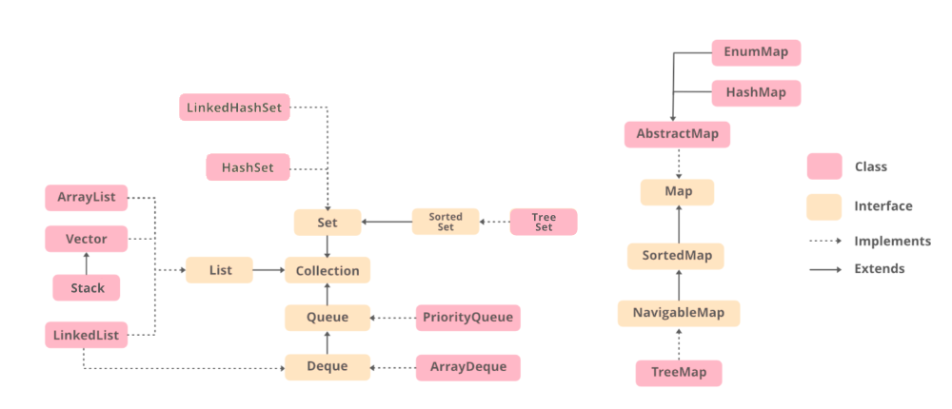
Inheritance, Encapsulation, Collections & I/O
Java Full Stack Program

Slide 16
Inheritance, Encapsulation, Collections & I/O
Before understanding the different components in the above framework, let’s first understand a class and an interface.
Class: A class is a user-defined blueprint or prototype from which objects are created. It represents the set of properties or methods that are common to all objects of one type.
Interface: Like a class, an interface can have methods and variables, but the methods declared in an interface are by default abstract (only method signature, no body). Interfaces specify what a class must do and not how. It is the blueprint of the class.
Java Full Stack Program

Slide 17
Inheritance, Encapsulation, Collections & I/O
Methods of the Collection Interface
This interface contains various methods which can be directly used by all the collections which implement this interface. They are:
Method | Description
add(Object) | This method is used to add an object to the collection.
addAll(Collection c) | This method adds all the elements in the given collection to this collection.
clear() | This method removes all of the elements from this collection.
contains(Object o) | This method returns true if the collection contains the specified element.
Java Full Stack Program

Slide 18
Inheritance, Encapsulation, Collections & I/O
Interfaces that extend the Collections Interface
The collection framework contains multiple interfaces where every interface is used to store a specific type of data. The following are the interfaces present in the framework.
1. Iterable Interface: This is the root interface for the entire collection framework. The collection interface extends the iterable interface. Therefore, inherently, all the interfaces and classes implement this interface. The main functionality of this interface is to provide an iterator for the collections. Therefore, this interface contains only one abstract method which is the iterator. It returns the
Iterator iterator();
Java Full Stack Program

Slide 19
Inheritance, Encapsulation, Collections & I/O
Collection Interface:
This interface extends the iterable interface and is implemented by all the classes in the collection framework. This interface contains all the basic methods which every collection has like adding the data into the collection, removing the data, clearing the data, etc. All these methods are implemented in this interface because these methods are implemented by all the classes irrespective of their style of implementation. And also, having these methods in this interface ensures that the names of the methods are universal for all the collections. Therefore, in short, we can say that this interface builds a foundation on which the collection classes are implemented.
Java Full Stack Program

Slide 20
Inheritance, Encapsulation, Collections & I/O
List Interface
This is a child interface of the collection interface. This interface is dedicated to the data of the list type in which we can store all the ordered collection of the objects. This also allows duplicate data to be present in it. This list interface is implemented by various classes like ArrayList, Vector, Stack, etc. Since all the subclasses implement the list, we can instantiate a list object with any of these classes. For example :
List <T> al = new ArrayList<> (); List <T> ll = new LinkedList<> (); List <T> v = new Vector<> (); Where T is the type of the object
Java Full Stack Program

Slide 21
Inheritance, Encapsulation, Collections & I/O
The classes which implement the List interface are as follows:
A. ArrayList: ArrayList provides us with dynamic arrays in Java. Though, it may be slower than standard arrays but can be helpful in programs where lots of manipulation in the array is needed. The size of an ArrayList is increased automatically if the collection grows or shrinks if the objects are removed from the collection. Java ArrayList allows us to randomly access the list. ArrayList can not be used for primitive types, like int, char, etc. We will need a wrapper class for such cases.
LinkedList: LinkedList class is an implementation of the LinkedList data structure which is a linear data structure where the elements are not stored in contiguous locations and every element is a separate object with a data part and address part. The elements are linked using pointers and addresses. Each element is known as a node.
Java Full Stack Program

Slide 22
Inheritance, Encapsulation, Collections & I/O
Vector :
A vector provides us with dynamic arrays in Java. Though, it may be slower than standard arrays but can be helpful in programs where lots of manipulation in the array is needed. This is identical to ArrayList in terms of implementation. However, the primary difference between a vector and an ArrayList is that a Vector is synchronized and an ArrayList is non-synchronized.
Stack : Stack class models and implements the Stack data structure. The class is based on the basic principle of last-in-first-out. In addition to the basic push and pop operations, the class provides three more functions of empty, search and peek. The class can also be referred to as the subclass of Vector.
Java Full Stack Program

Slide 23
Inheritance, Encapsulation, Collections & I/O
Queue Interface: As the name suggests, a queue interface maintains the FIFO(First In First Out) order similar to a real-world queue line. This interface is dedicated to storing all the elements where the order of the elements matter.
For example, whenever we try to book a ticket, the tickets are sold on a first come first serve basis. Therefore, the person whose request arrives first into the queue gets the ticket. There are various classes like PriorityQueue, ArrayDeque etc. Since all these subclasses implement the queue, we can instantiate a queue object with any of these classes.
Queue <T> pq = new PriorityQueue<> (); Queue <T> ad = new ArrayDeque<> (); Where T is the type of the object.
Java Full Stack Program

Slide 24
Inheritance, Encapsulation, Collections & I/O
The most frequently used implementation of the queue interface is the PriorityQueue. Priority Queue:
A PriorityQueue is used when the objects are supposed to be processed based on the priority. It is known that a queue follows the First-In-First-Out algorithm, but sometimes the elements of the queue are needed to be processed according to the priority and this class is used in these cases. The PriorityQueue is based on the priority heap. The elements of the priority queue are ordered according to the natural ordering, or by a Comparator provided at queue construction time, depending on which constructor is used
Java Full Stack Program

Slide 25
Inheritance, Encapsulation, Collections & I/O
Deque Interface:
This is a very slight variation of the queue data structure. Deque, also known as a double-ended queue, is a data structure where we can add and remove the elements from both ends of the queue.
This interface extends the queue interface. The class which implements this interface is ArrayDeque. Since ArrayDeque class implements the Deque interface, we can instantiate a deque object with this class.
Deque<T> ad = new ArrayDeque<> (); Where T is the type of the object.
Java Full Stack Program

Slide 26
Inheritance, Encapsulation, Collections & I/O
The class which implements the deque interface is ArrayDeque.
ArrayDeque: ArrayDeque class which is implemented in the collection framework provides us with a way to apply resizable-array. This is a special kind of array that grows and allows users to add or remove an element from both sides of the queue. Array deques have no capacity restrictions and they grow as necessary to support usage
Set Interface: A set is an unordered collection of objects in which duplicate values cannot be stored. This collection is used when we wish to avoid the duplication of the objects and wish to store only the unique objects. This set interface is implemented by various classes like HashSet, Tree set, linked set etc. Since all the subclasses implement the set, we can instantiate a set object with any of these classes
Java Full Stack Program

Slide 27
Inheritance, Encapsulation, Collections & I/O
Java I/O (Input and Output) is used to process the input and produce the output.
Java uses the concept of a stream to make I/O operation fast. The java.io package contains all the classes required for input and output operations.
We can perform file handling in Java by Java I/O API.
Stream
A stream is a sequence of data. In Java, a stream is composed of bytes. It's called a stream because it is like a stream of water that continues to flow.
In Java, 3 streams are created for us automatically. All these streams are attached with the console.
1) System.out: standard output stream
2) System.in: standard input stream
3) System.err: standard error stream
Java Full Stack Program

Slide 28
Inheritance, Encapsulation, Collections & I/O
OutputStream vs InputStream
The explanation of OutputStream and InputStream classes are given below:
OutputStream
Java application uses an output stream to write data to a destination; it may be a file, an array, peripheral device or socket.
InputStream
Java application uses an input stream to read data from a source; it may be a file, an array, peripheral device or socket.
Let's understand the working of Java OutputStream and InputStream by the figure given below.
Java Full Stack Program

Slide 29
Inheritance, Encapsulation, Collections & I/O
Java Full Stack Program

Slide 30
Inheritance, Encapsulation, Collections & I/O
OutputStream class
OutputStream class is an abstract class. It is the superclass of all classes representing an output stream of bytes. An output stream accepts output bytes and sends them to some sink.
Method | Description
1) public void write(int)throws IOException | is used to write a byte to the current output stream.
2) public void write(byte[])throws IOException | is used to write an array of byte to the current output stream.
Java Full Stack Program

Slide 31
Inheritance, Encapsulation, Collections & I/O
Java Full Stack Program

Slide 32
Inheritance, Encapsulation, Collections & I/O
InputStream class
InputStream class is an abstract class. It is the superclass of all classes representing an input stream of bytes.
Useful methods of InputStream
Java Full Stack Program

Slide 33
Inheritance, Encapsulation, Collections & I/O
OutputStream vs InputStream
The explanation of OutputStream and InputStream classes are given below:
OutputStream
Java application uses an output stream to write data to a destination; it may be a file, an array, peripheral device or socket.
InputStream
Java application uses an input stream to read data from a source; it may be a file, an array, peripheral device or socket.
Let's understand the working of Java OutputStream and InputStream by the figure given below.
Java Full Stack Program

